Slide 1

Capstone Project Phase B Behavioral Biometrics For Continuous User Authentication
Students:
Rafael Elkoby
Dan Gutchin
Supervisors:
Dr. Dan Lemberg
Mrs. Elena Kramer
Capstone Project Phase B (22-1-R-2)
June 2022

Slide 2
Overview
Introduction
1D CNN (Stage 1)
LSTM (Stage 2)
Background and Related Work
Data
Models
2LSTM
1D + 1LSTM
1D + 2LSTM
Results
Model comparison
ROC
F1 Score
FAR, FRR and EER
System demonstration

Slide 3
Introduction

Slide 4
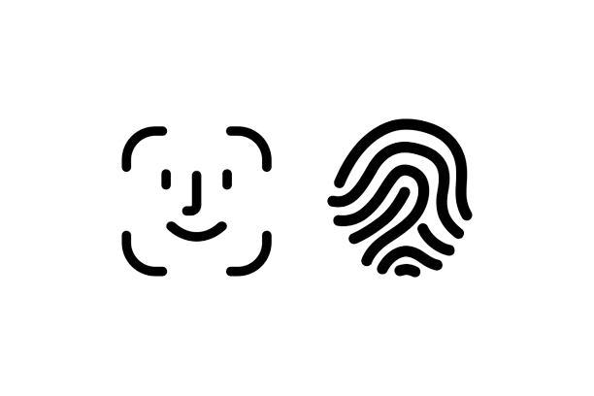

Introduction
biometric authentication
Today most of us already use biometric authentication methods
These methods mostly require dedicated hardware
Methods in use today are primarily used for single-time authentication

Slide 5

Introduction
What do we want?
We focus on the most common hardware used today
Get a sufficient authentication of a user during his use of the app
Finding the best method and to implement it

Slide 6
keystroke dynamics is not what you type, but how you type

Slide 7
1D CNN

Slide 8
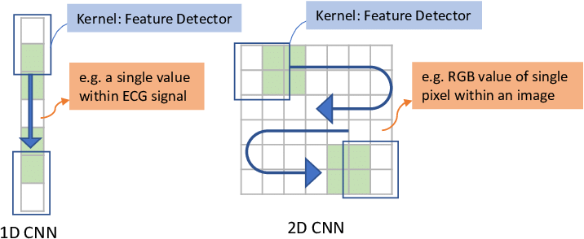
1D CNN
General and 1D vs 2D
Derive interesting features from shorter segments
Applies well to the analysis of time sequences
The dimensions of the input data
The kernel of a 1D CNN Moves in a vertical way

Slide 9
LSTM

Slide 10
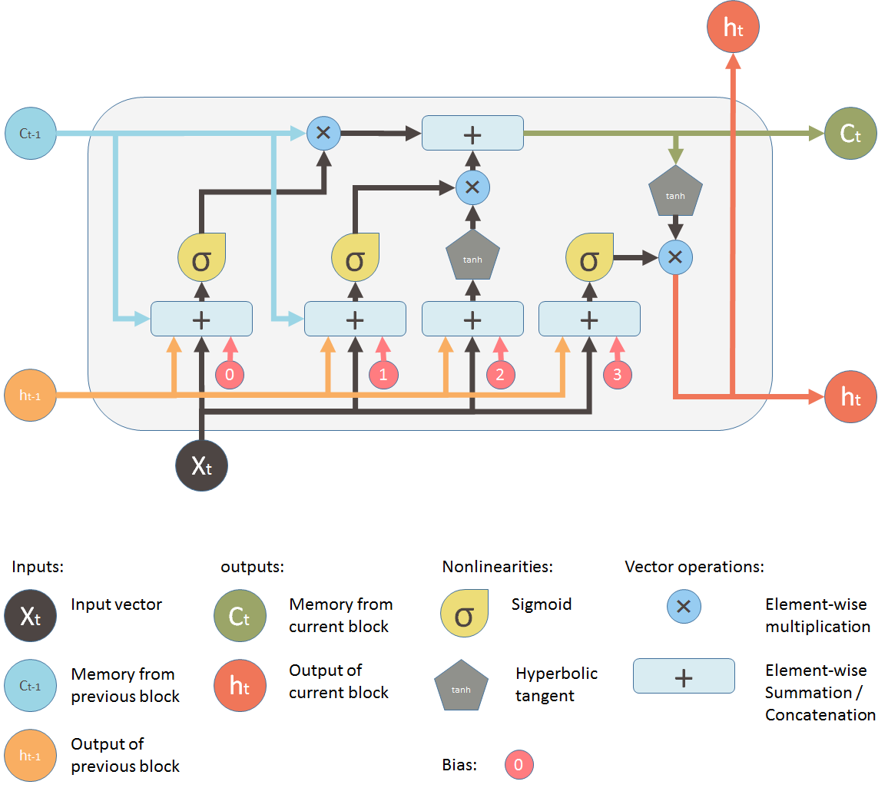
LSTM
General overview
Composed of multiple gates
Each gate has a single layered NN
Connected to the next last cell

Slide 11
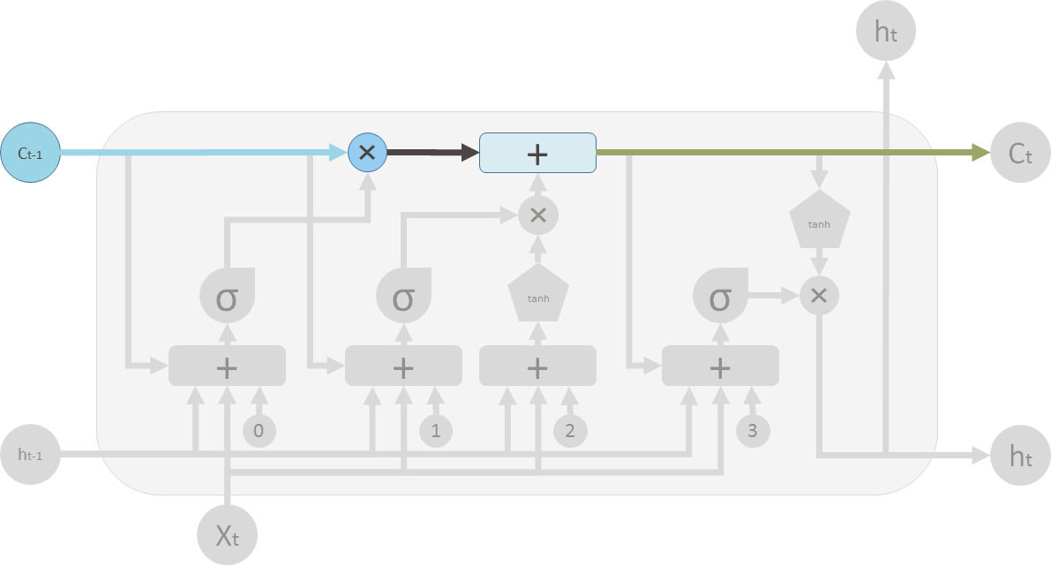
LSTM
Main Stream

Slide 12
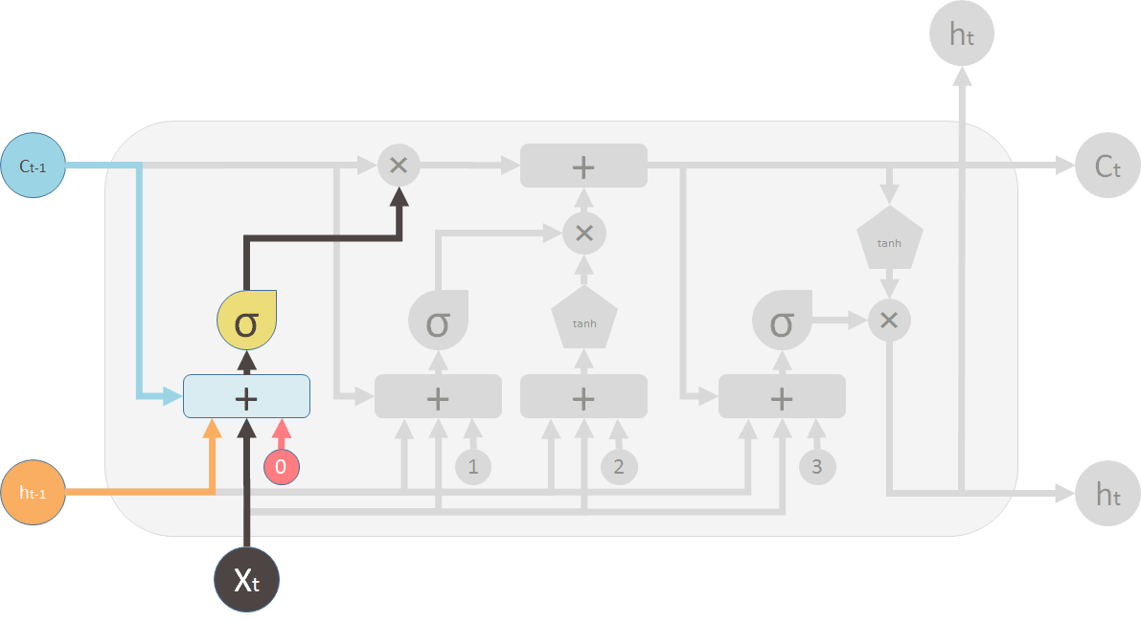
LSTM
Forget gate

Slide 13
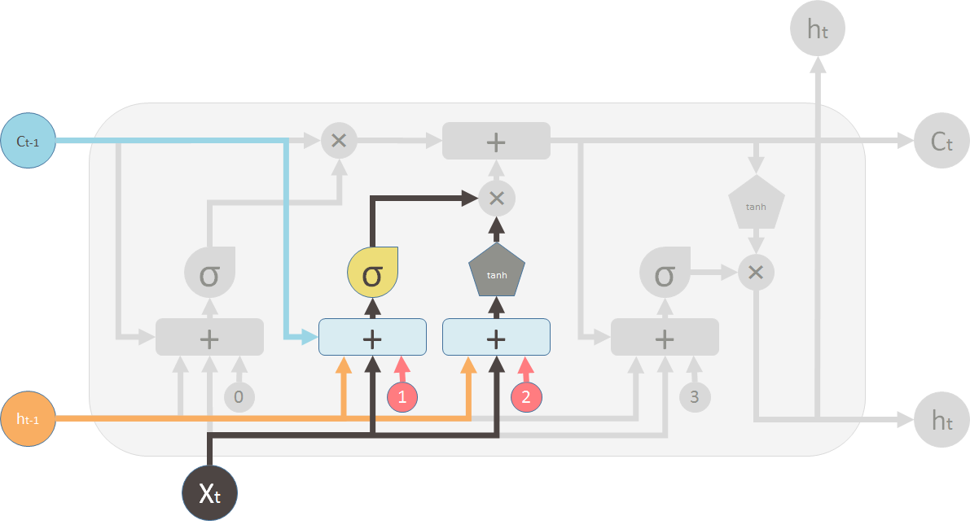
LSTM
Cell state

Slide 14
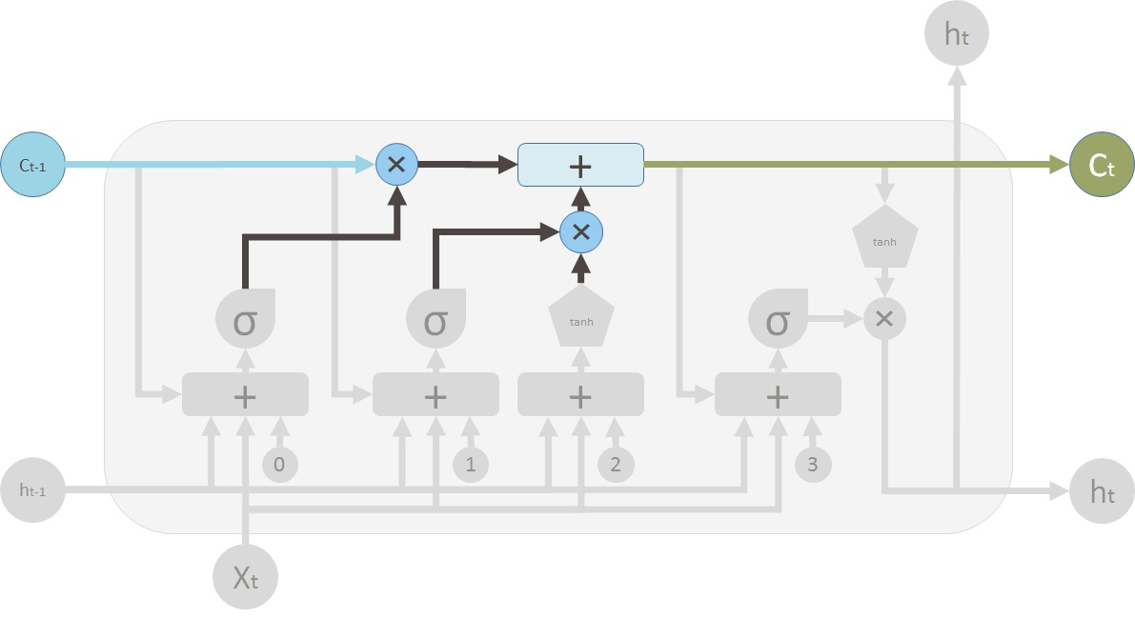
LSTM
Old memory vs new memory

Slide 15
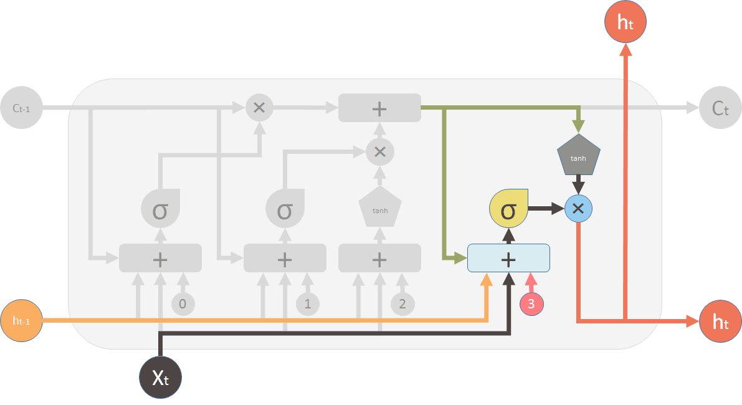
LSTM
LSTM output

Slide 16
Background and Related Work

Slide 17
Background and Related Work
Most of the publications in the field are about fixed text.
KNN, SVM and clustering methods in general are inferior to ANNs in free text learning.

Slide 18
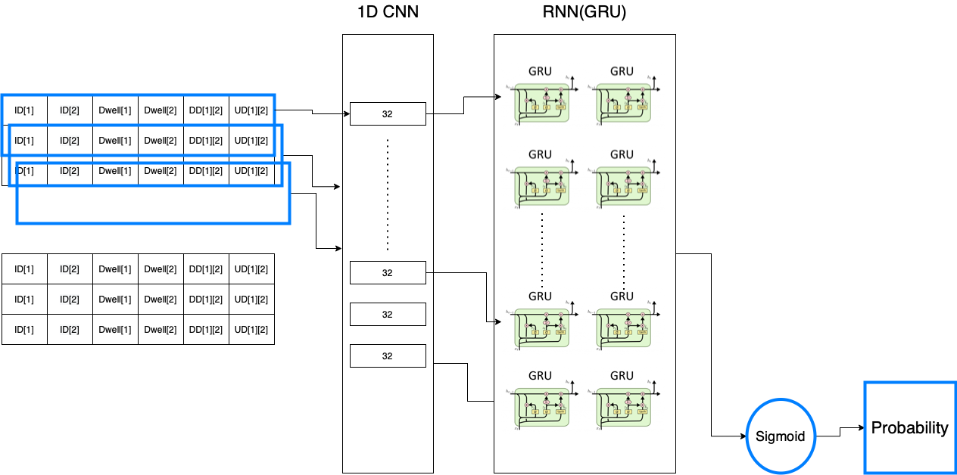
System overview
Proposed architectures

Slide 19
Data

Slide 20
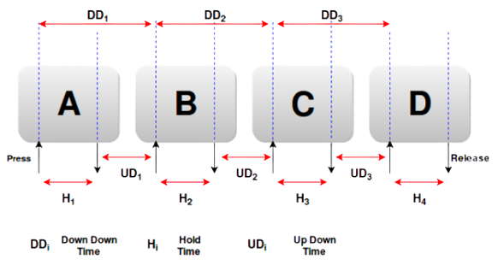
Data
Features
Hold time (dwell time) The duration for which the key is held down means the time between pressing the button and releasing the button.
Down-Down time This is a time between when key1 was pressed, and key2 was pressed.
Up-Down Time This is the time between when key1 was released to when key2 was pressed.

Slide 21
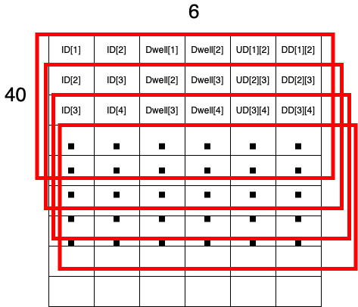
Data
Format and Sliding window
We tried a verity of window sizes to find the best one for our use
Sliding window is a method used to get more data
Get more refined features

Slide 22
Data
Data collection & Buffalo
Data collection program -
We Built a program for data collection
Amazon E3 database service
Used our format
Buffalo dataset -
Data needed to be manipulated
148 subjects in 3 separate laboratory sessions
Each session contains 5.7k keystrokes
Each user wrote a free text file and a fixed text file each session

Slide 23
Models

Slide 24
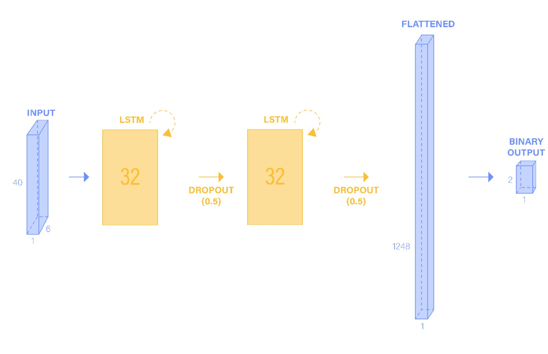
Models
2LSTM
Window size of 40
2 LSTM layers
Flattened layer
A fully connected layer with 2 outputs

Slide 25
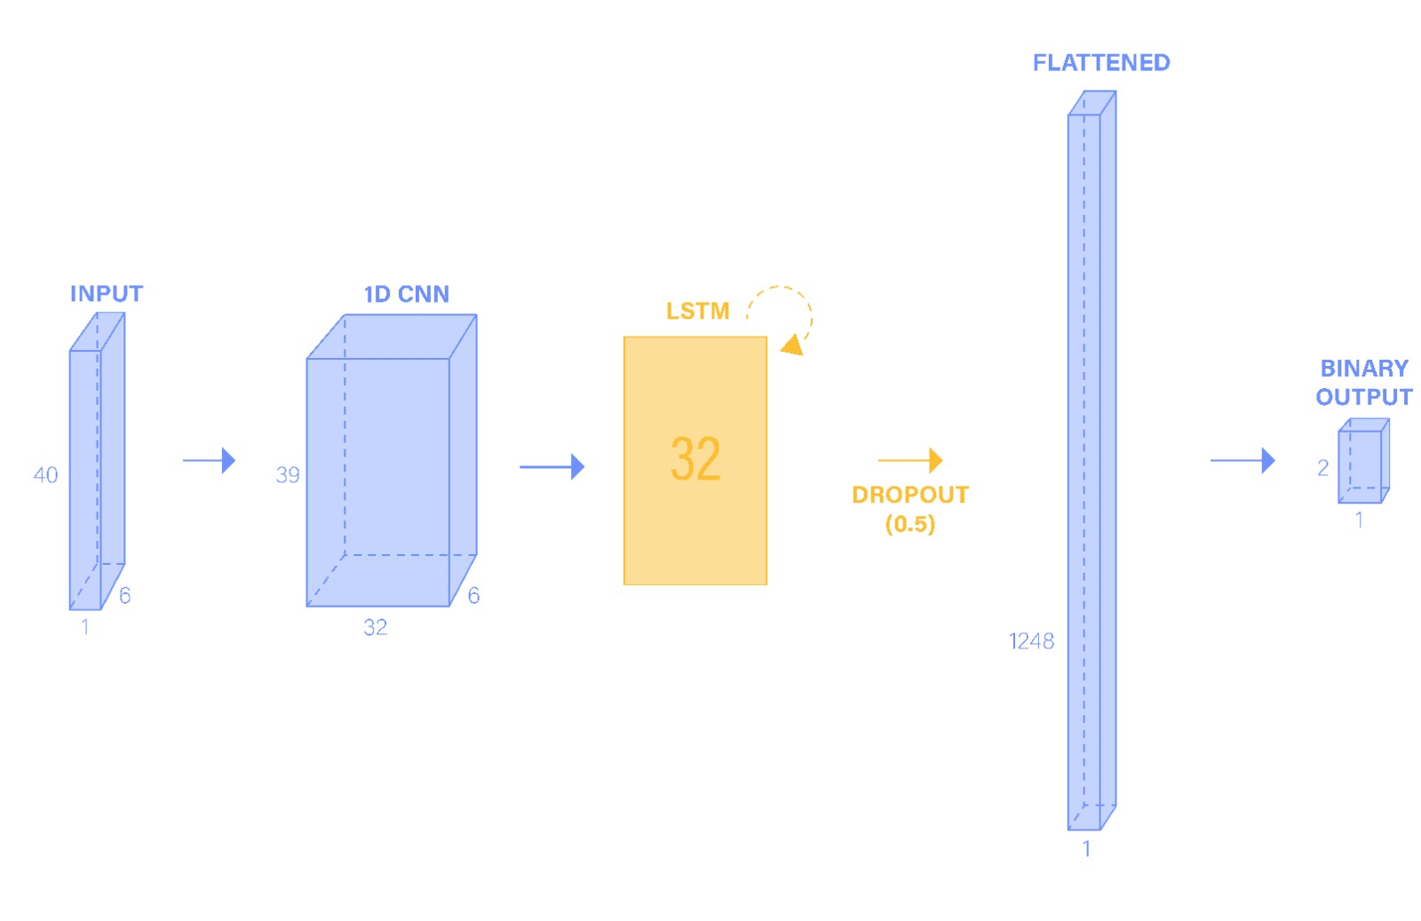
Models
1D 1LSTM
Window size of 40
1D CNN
1 LSTM layer
Flattened layer
A fully connected layer with 2 outputs

Slide 26
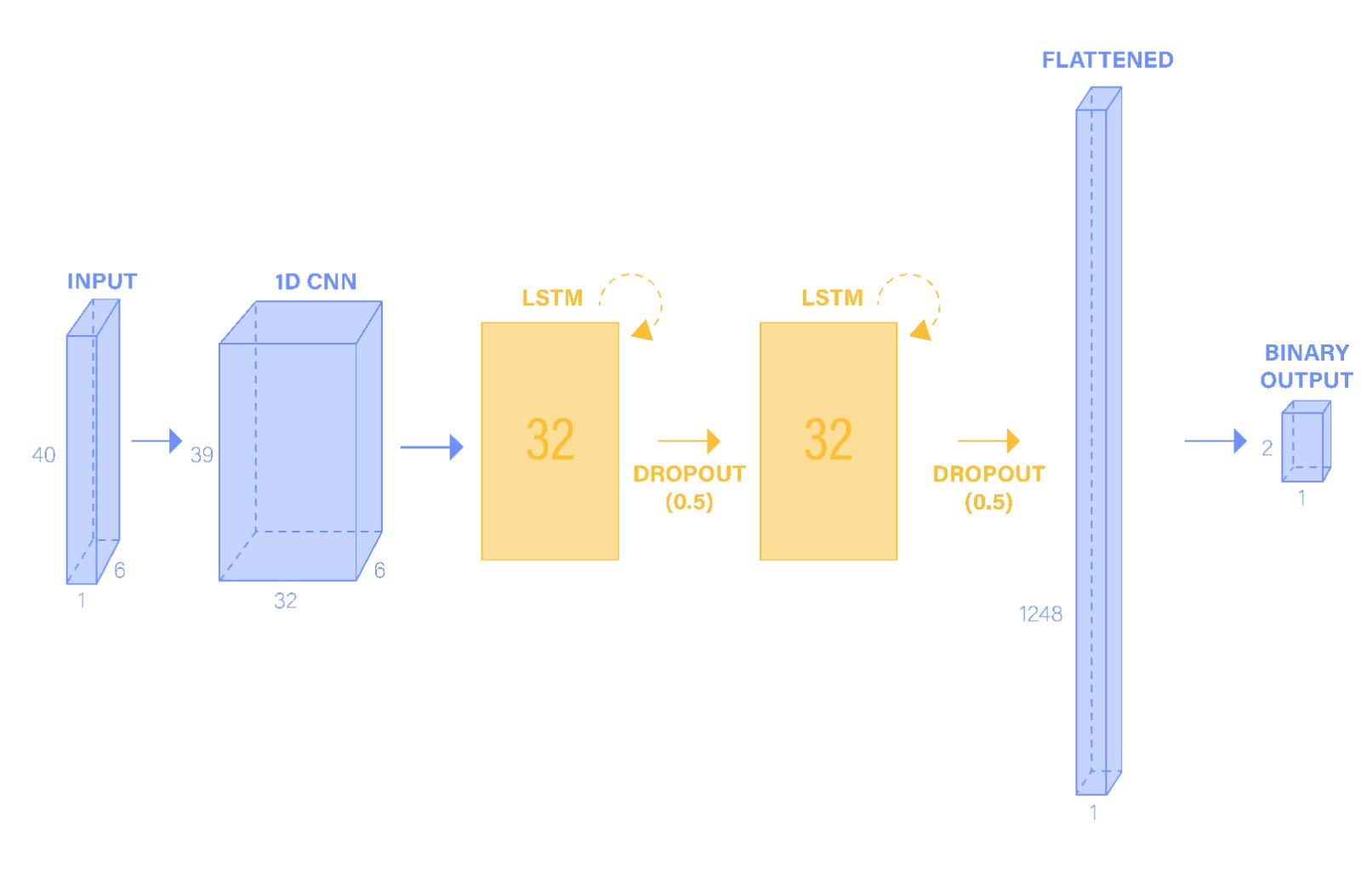
Models
1D 2LSTM
Window size of 40
1D CNN
2 LSTM layer
Flattened layer
A fully connected layer with 2 outputs

Slide 27
Results

Slide 28
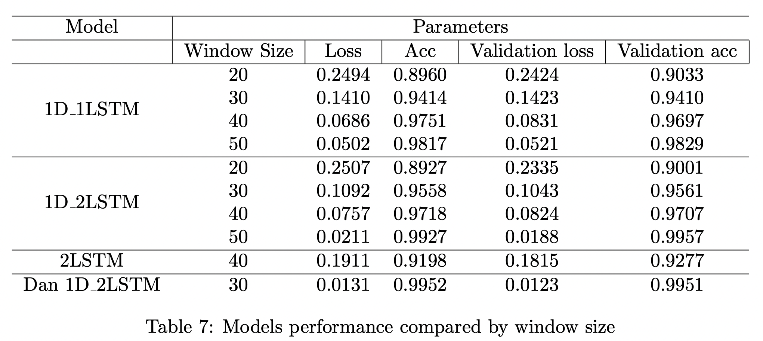
Results
Model Comparison

Slide 29
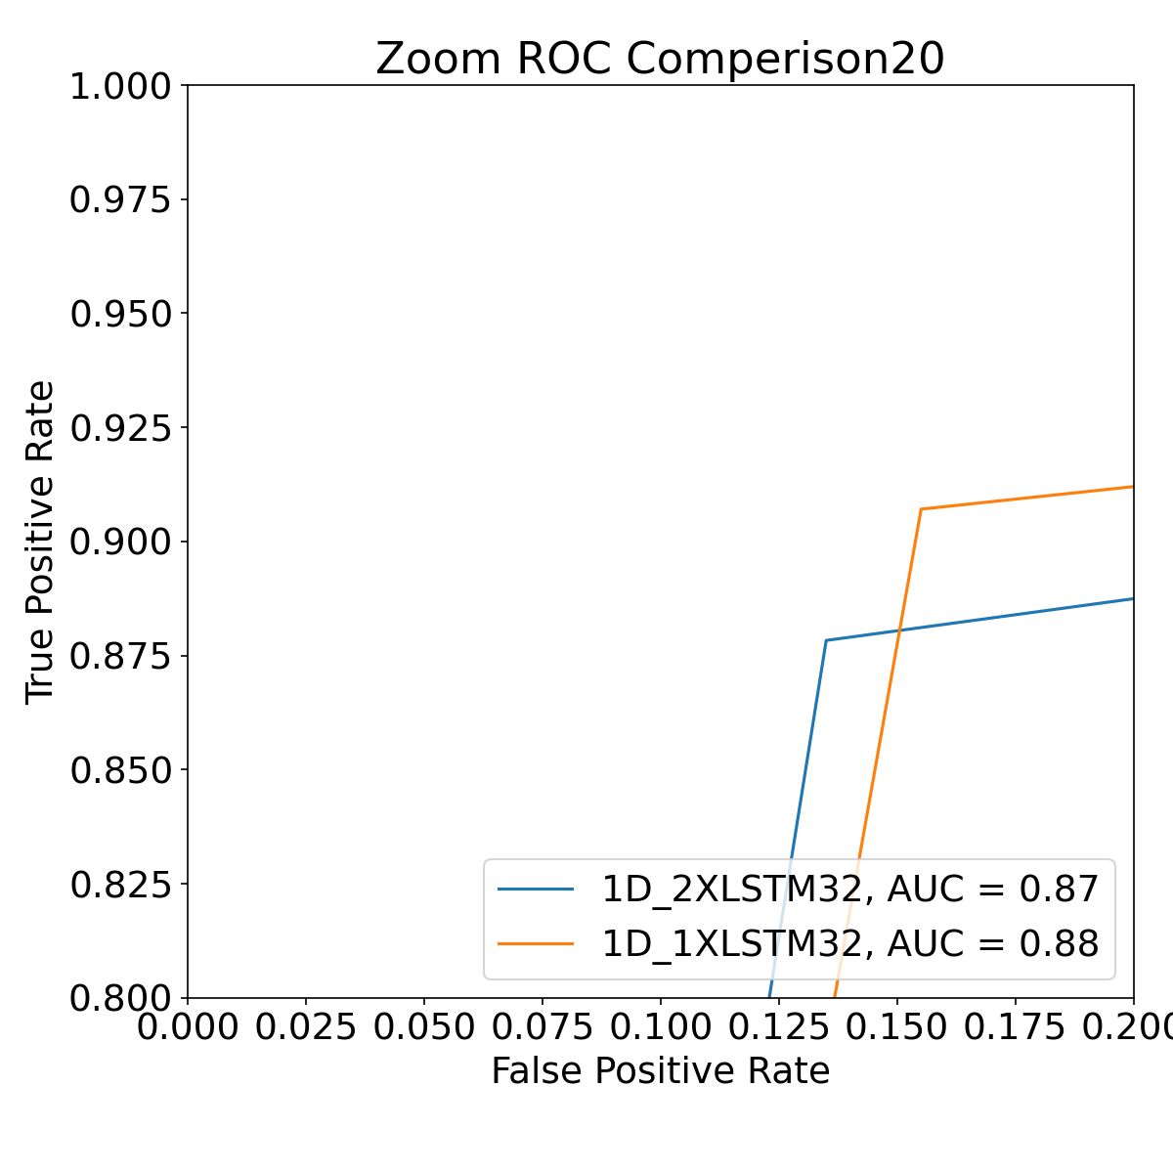
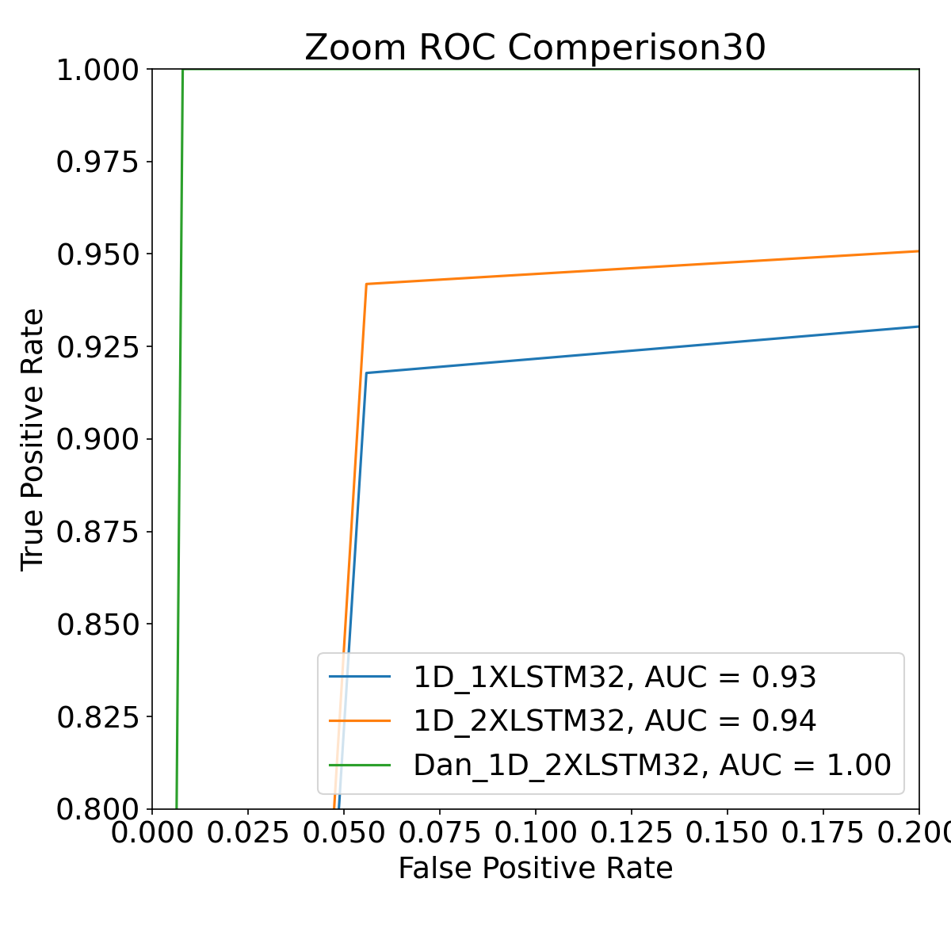
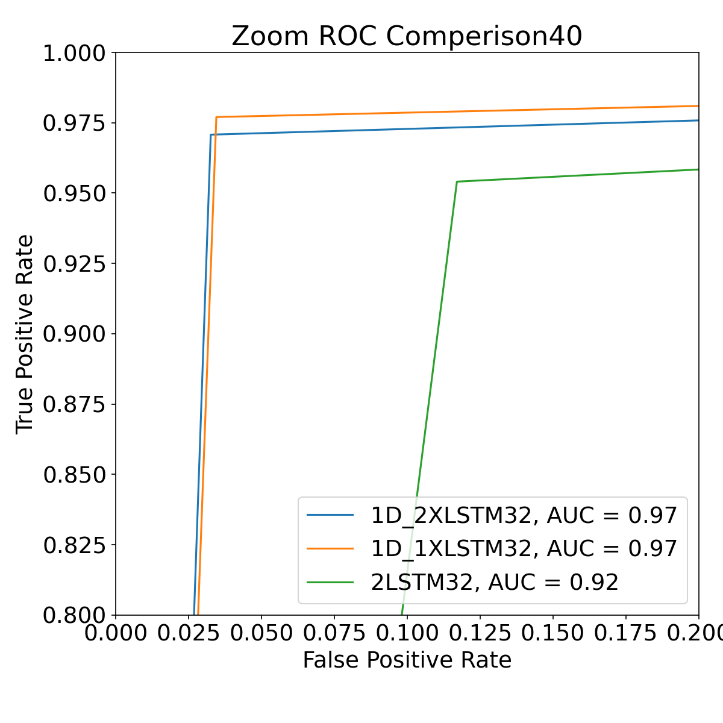
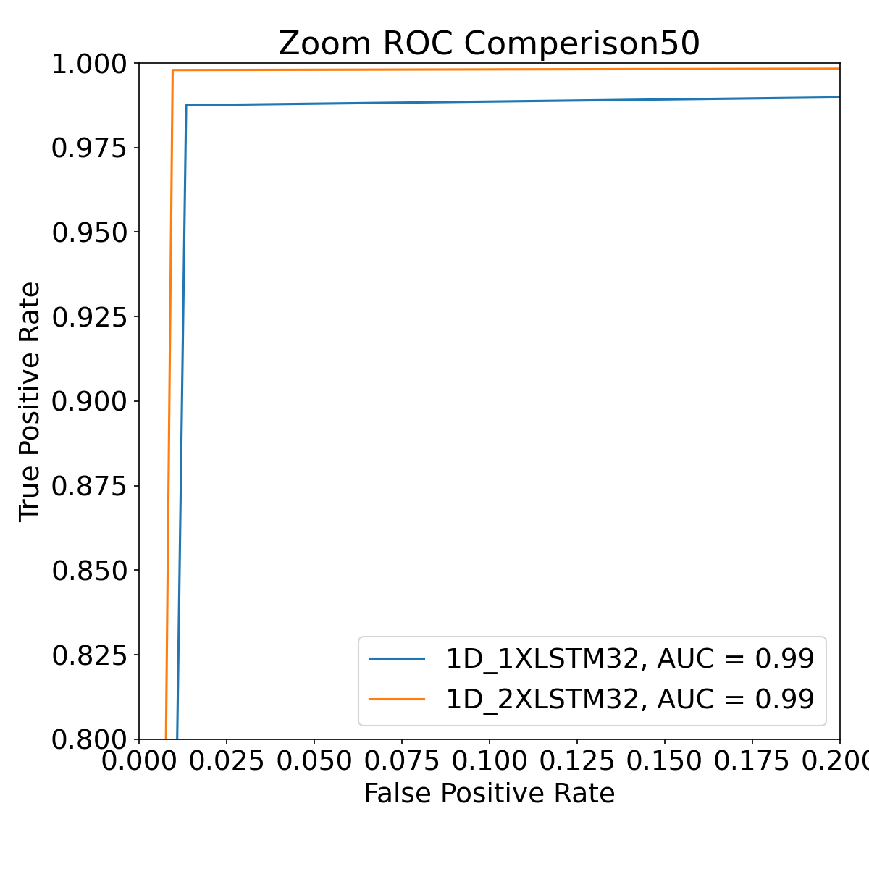
Results
ROC

Slide 30
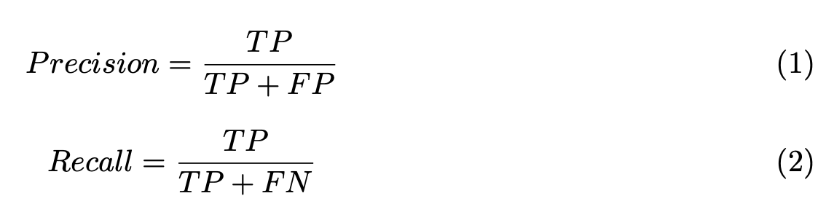
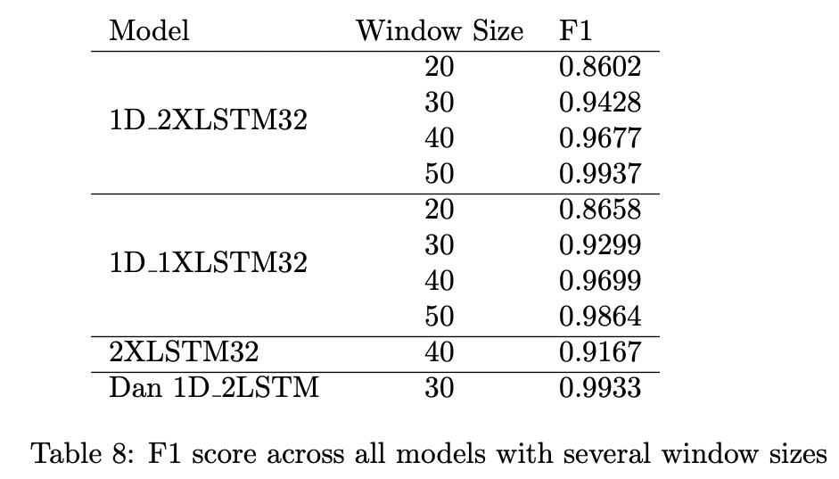
Results
F1 Score
Precision: Of all positive predictions, how many are really positive?
Recall: Of all real positive cases, how many are predicted positive?
What if we want both?
The F1-score combines the precision and recall of a classifier into a single metric by taking their harmonic mean

Slide 31
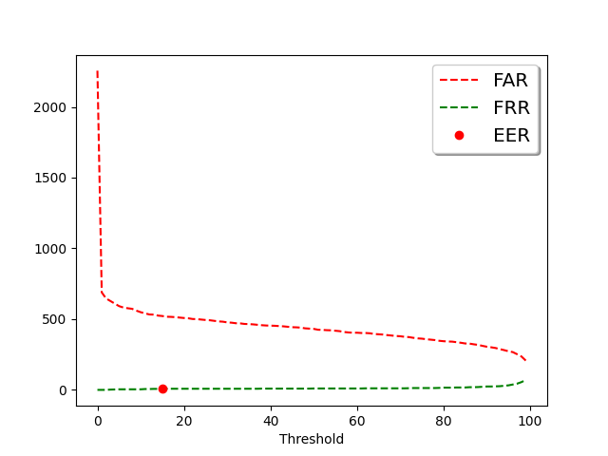
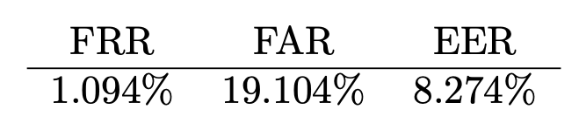
Results
FRR, FAR and EER
False Acceptance Rate (FAR) - The proportion of times a system grants access to an unauthorized person
False Rejection Rate (FRR) - The proportion of times a biometric system fails to grant access to an authorized person.
Equal error rate (EER) - A biometric security system algorithm used to predetermines the threshold values for its false acceptance rate and its false rejection rate.

Slide 32
System demonstration

Slide 33
Thank You !

